Slide 1




Using to Provision and Configure Infrastructure on Azure
Ryan Staatz
DevOps Maestro, LogDNA
@baronomasia
Jason Poon
Sr. Software Engineer, Microsoft
@jasonthepoon
Notes:
[Both] - Introductions

Slide 2

AGENDA
LogDNA
Salt Cloud
Demo
Questions
Our Journey to Salt
Provisioning VMs with Salt Cloud
Configuring an Elasticsearch cluster
Notes:
[Jason]
LogDNA + Microsoft collaboration
Critical workload = elasticsearch

Slide 3
Cloud log management platform
YC 2015
Teamed up with Microsoft
Use Saltstack to manage infrastructure
Notes:
[Ryan] – Where logdna came from (bash scripts). Why we chose Salt stack.

Slide 4
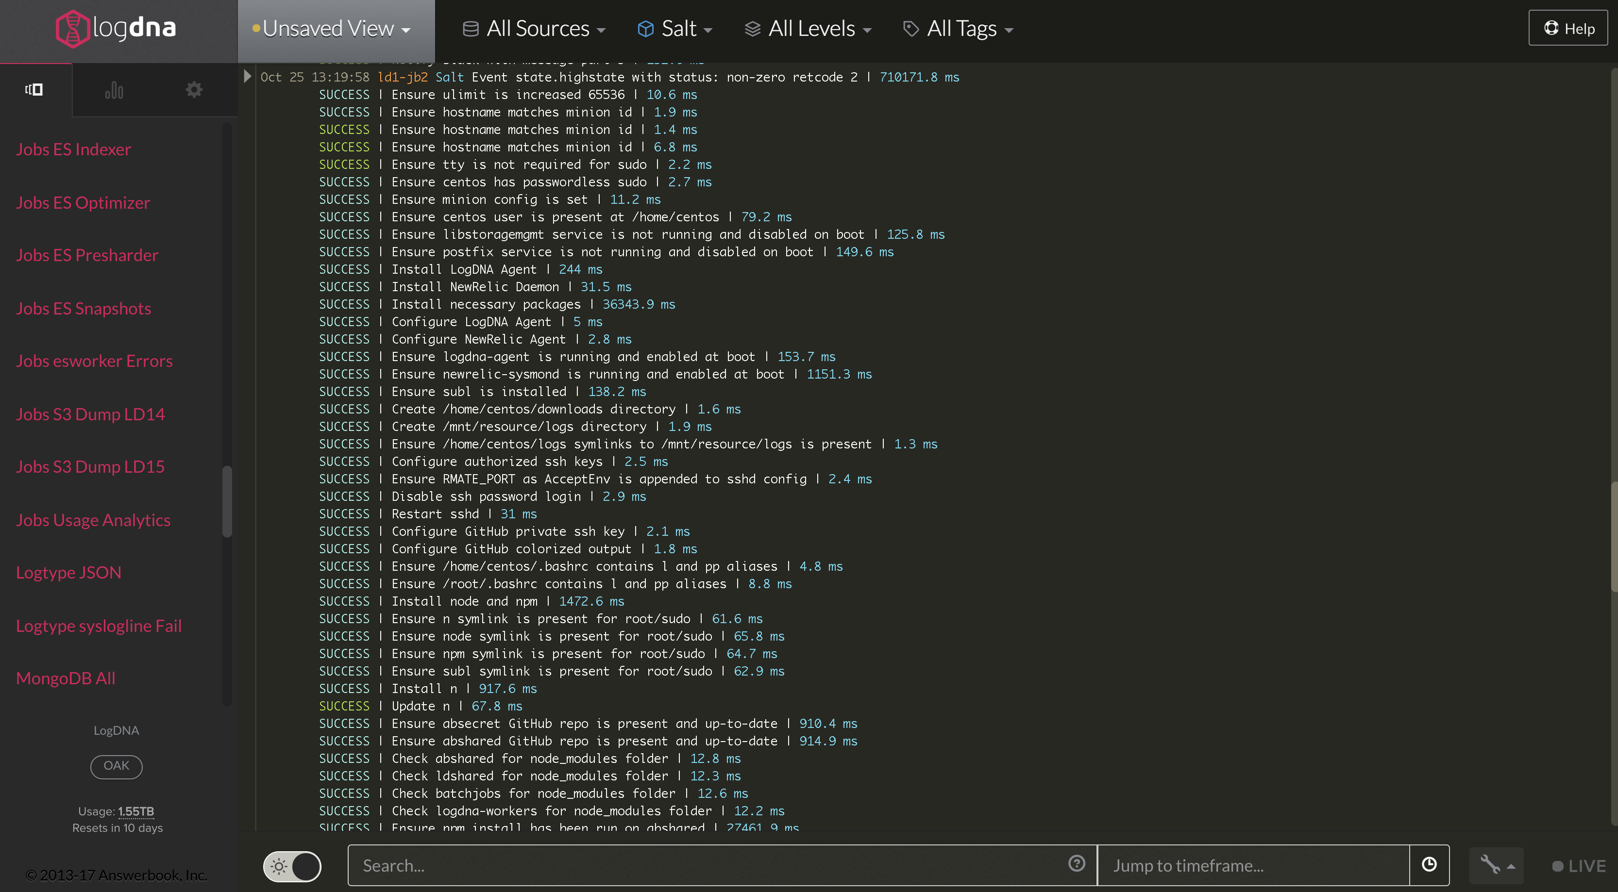
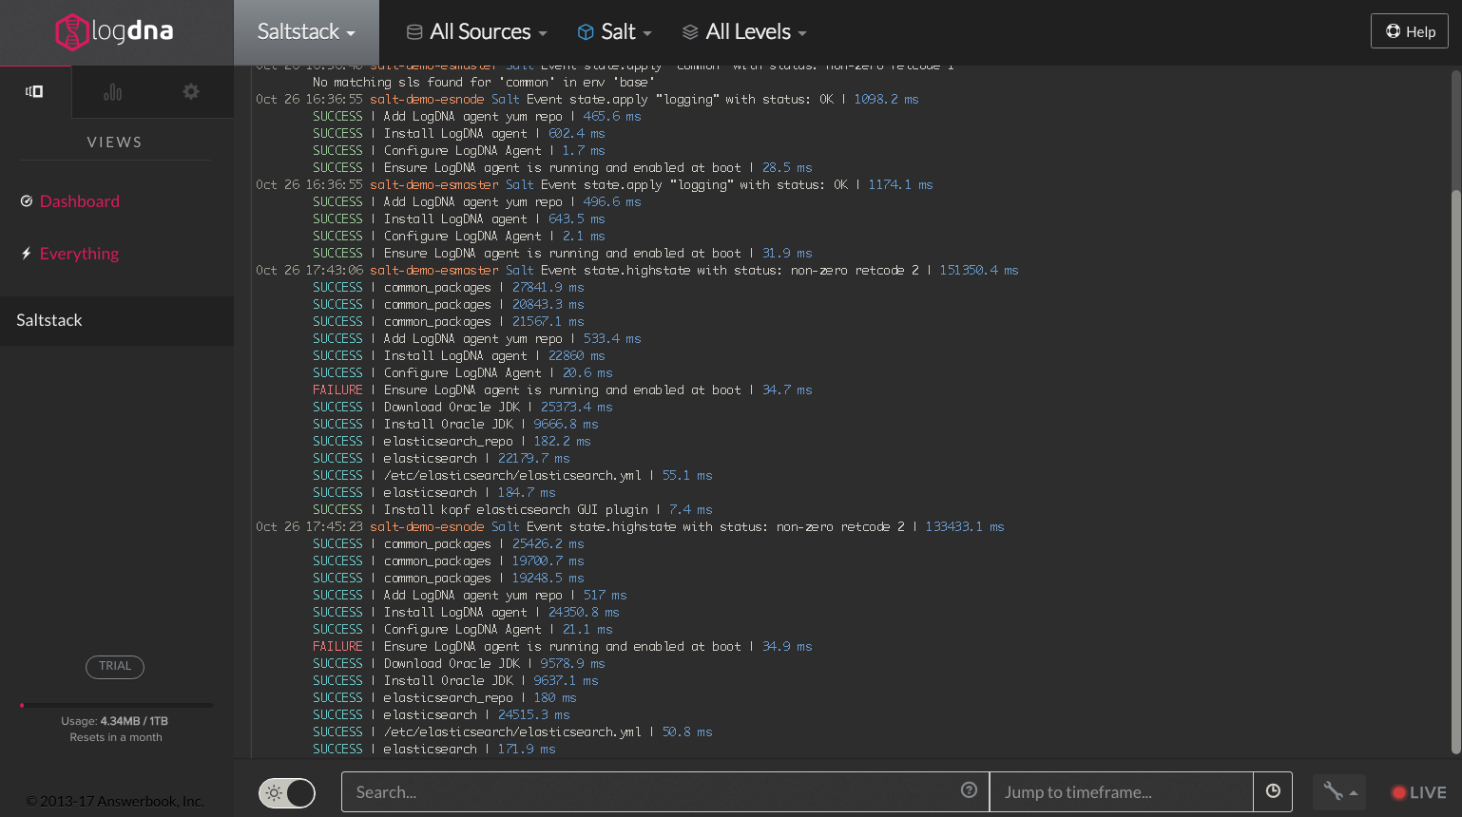
Notes:
[Ryan]

Slide 5

INFRASTRUCTURE IS COMPLICATED
Provision Network
Provision Machines
Install Dependencies
Retrieve App
Run App
Monitoring/Logging
Cloud Portal
Bash Script
ssh
apt-get <blah>
git clone <app>
./app
Notes:
[Ryan]

Slide 6
INFRASTRUCTURE IS COMPLICATED
AS CODE
Provision Network
Provision Machines
Install Dependencies
Retrieve App
Run App
Monitoring/Logging
Azure Resource Template
Salt Cloud
Notes:
[Ryan]

Slide 7


OUR JOURNEY TO SALT
Why we chose Saltstack:
Native cloud provider integrations, including Azure
Highly scalable
Highly performant
State enforcement
Cross-platform compatible
...because it's awesome!
Notes:
[Ryan] – Where logdna came from (bash scripts). Why we chose Salt stack.

Slide 8

Demo
on with
Elasticsearch
Azure
SaltStack
Notes:
[Jason]
- kick off demo

Slide 9






Port 9200
Azure Resource Template
./bootstrap-salt.sh
Salt Master
Elasticsearch
Master
Storage
Account
salt-cloud
Elasticsearch
Slave
salt ‘*’ state.highstate
Virtual
Network
Network Security
Group
Notes:
[Jason]
Azure ARM - Similar to CloudFormation templates. Defines the topology of the resources you want to deploy onto Azure. VM/Storage Account/VNet
Start demo “./deploy-salt-cluster.sh -o create -u jason -g japoon-saltstack”

Slide 10
MICROSOFT AZURE
Azure Resource Manager (ARM):
Azure Control Plane
Classic vs ARM
Azure Resource Manager (ARM) Templates:
JSON file that defines infrastructure and configuration
Simplifies orchestration and ensure idempotency
QuickStart Templates: github.com/Azure/azure-quickstart-templates
ARM Visualizer: armviz.io
Notes:
[Jason]
Classic vs. ARM
Consistent management layer (Azure CLI, portal, rest, development SDKs)
ARM Templates: Idempotent, cross-resource configuration, update support
Show ARM template, armviz.io, quickstart
Show beginning of start-up script

Slide 11







SALT
Salt Cloud
Natively spin up and bootstrap systems on your cloud provider
Salt Cloud supports the ARM provisioning model
Salt cloud providers require specific configuration and dependencies
…and many others
Notes:
[Jason]

Slide 12
SALT CLOUD CONFIGURATION
Notes:
[Jason]
/etc/salt/cloud:
global settings that apply to all cloudhosts
E.g. minion configuration,
/etc/salt/cloud.providers.d/*.conf
settings and configs for a specific cloud host
/etc/salt/cloud.profiles.d/*.conf
settings and specs for each specific VM type
Service Principal => Service Account that you can scope permissions

Slide 13
SALT
Salt Stack
Minions
Execution Modules
Formulas (States)
Grains
Top File
Notes:
[Ryan]

Slide 14
Top File
Formula Files
base:
‘*’:
- common_packages
- logging
‘roles:elasticsearch‘:
- match: grain
- elasticsearch
'roles:elasticsearchmaster’:
- match: grain
- elasticsearchmaster
common_packages:
pkg.installed:
- names:
- git
- tmux
- tree
/etc/salt/common_packages.sls
/etc/salt/top.sls

Slide 15
SUMMARY
Use ARM templates to simplify orchestration
salt-cloud abstracts the nitty gritty details of a cloud provider
salt configures and runs the software
LogDNA Salt engine ingests state run results
Notes:
[Jason]

Slide 16
RESOURCES
Code Story www.microsoft.com/reallifecode/2017/05/09/provision-configure-infrastructure-azure-using-saltstack/
ElasticSearch on Azure using SaltStack www.github.com/baronomasia/azure-saltstack-elasticsearch
LogDNA https://logdna.com
Using an existing formula (MySQL) www.github.com/jpoon/azure-saltstack-mysql

Slide 17

Questions?

Slide 18














General

Slide 19
Electronics
Miscellaneous

Slide 20
E-Commerce
Web

Slide 21
Arrows
Location
Weather

Slide 23
